Slide 1
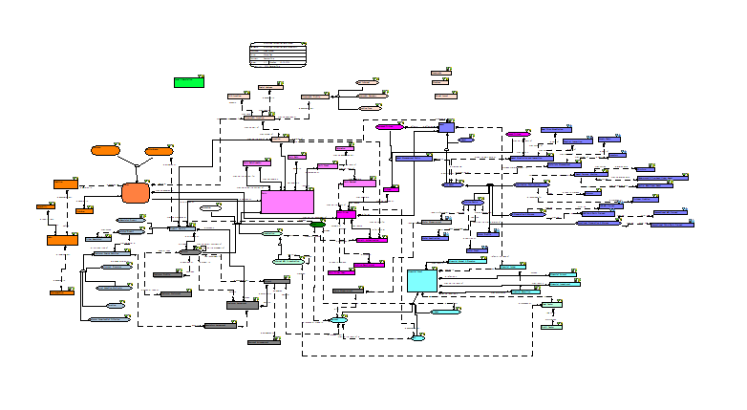
Enterprise Data Models Approval Process
Why Enterprise Data Models?
It’s an overarching data model covering all business areas which describes the essence of an entire organization
It enables a view of how the various parts of the organization’s data estate relate to each other
By intent the EDM is incomplete
Enterprise Data Models are
Enterprise Conceptual Data Model
Enterprise Logical Data Model
The Conceptual model
The Conceptual Data Model identifies and defines the primary data concepts and relationships about which the business keeps data that runs the business. It shows the very high-level key data concepts, their definitions, and how they relate to each other. It’s the business landscape in business terms.
The Logical model
The Logical Data Model represents the data/information requirements of the business. It identifies the business data (entities), how they are related (relationships) and the business data (attributes) that is required to support the business.

Slide 2
Enterprise Data Models Approval Process
What’s in our current Data Modeling Standards?
Model Governance
Peer Review Checklists for each type of model
Based on list of model tasks and processes
Key aspect is re-use of all data object types
Data Delivery will perform physical model reviews
TDA performs conceptual and logical model reviews
What do we need to confirm or add?
BU model alignment review – TDA will work with BUs/GFs to ensure default align with the Enterprise Data Models
Model exception process – TDA will work with the cross functional and domain groups to address exceptions and recommend solutions.
Model exception approval – The recommended exception solution will be presented to the ED&A SC for approval

